Slide 1
Architektura
głębokich sieci neuronowych
Weronika Hryniewska

Slide 2
Tensorflow playground
https://playground.tensorflow.org
Jak wielkość sieci wpływa na szybkość trenowania?
Czy można różnymi cechami rozwiązać to samo zadanie?
Co robi learning rate, albo funkcja aktywacji?
Co się stanie, gdy: zmienimy batch size, podział danych lub dodamy szum?
Co jest bardziej korzystne – zwiększenie neuronów w warstwach czy liczby warstw?
Czy lepiej wziąć za dużą sieć, czy za małą?

Slide 3
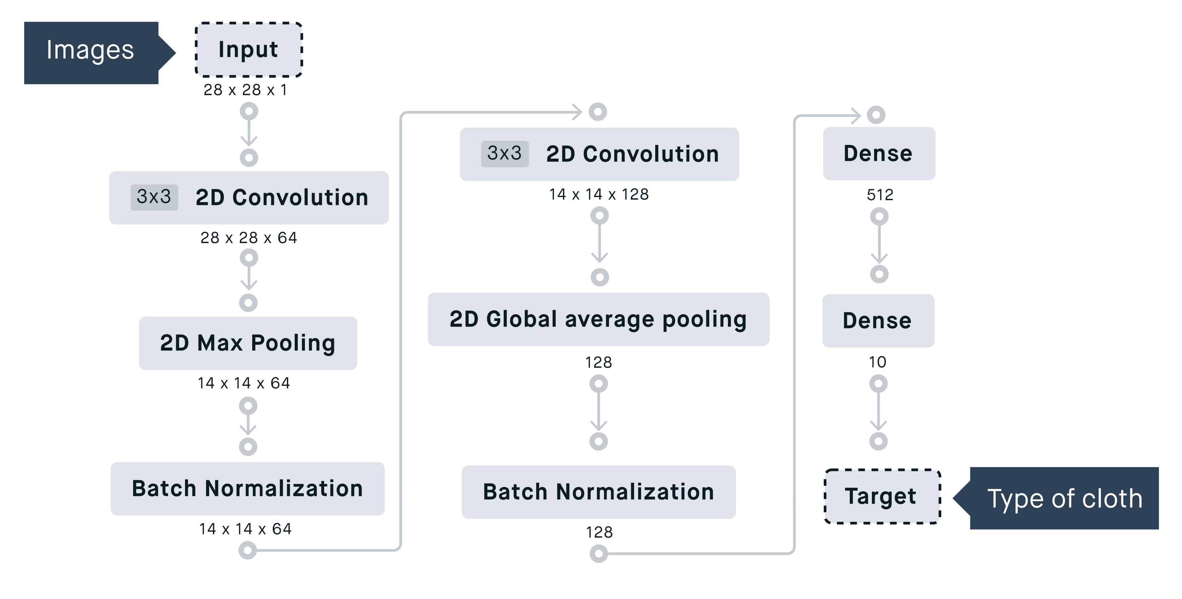
https://peltarion.com/knowledge-center/documentation/modeling-view/build-an-ai-model/blocks/

Slide 4
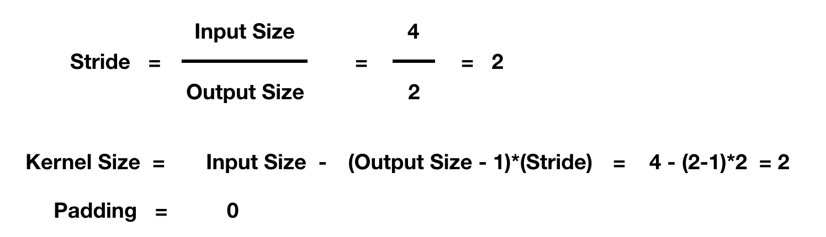
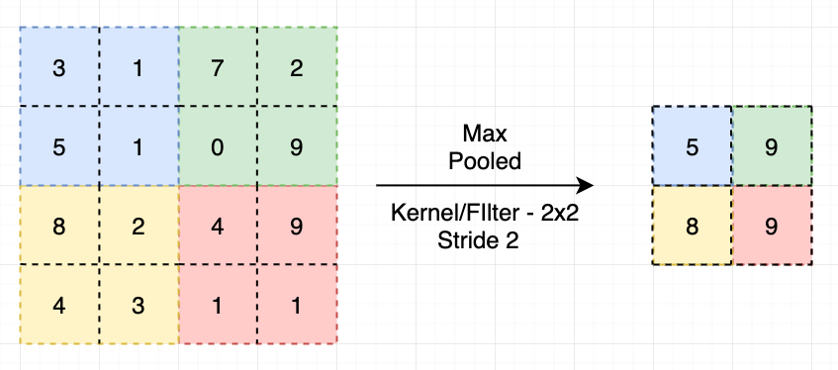
Max pooling
Stride 2
Kernel 2x2
https://ai.plainenglish.io/pooling-layer-beginner-to-intermediate-fa0dbdce80eb

Slide 5
Padding i stride
https://towardsdatascience.com/covolutional-neural-network-cb0883dd6529

Slide 6
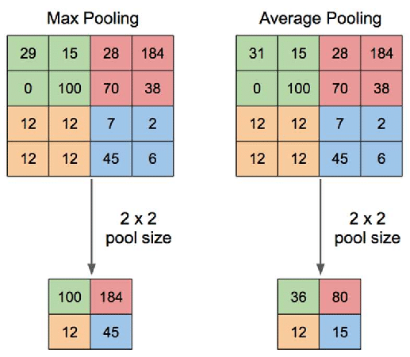
www.quora.com/What-is-max-pooling-in-convolutional-neural-networks

Slide 7
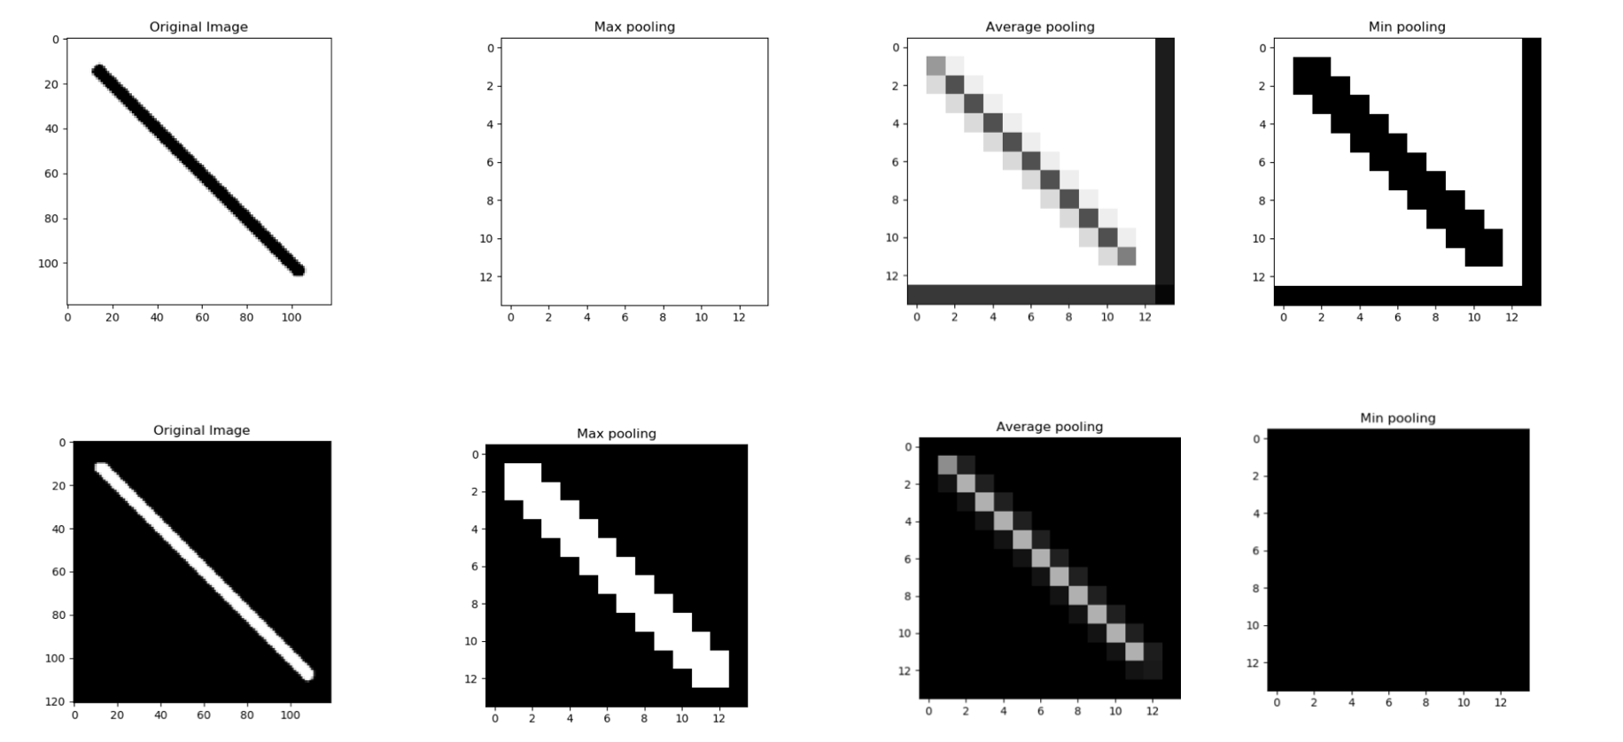
Porównanie operacji poolingu
0 - czarny
255 - biały
https://iq.opengenus.org/pooling-layers

Slide 8
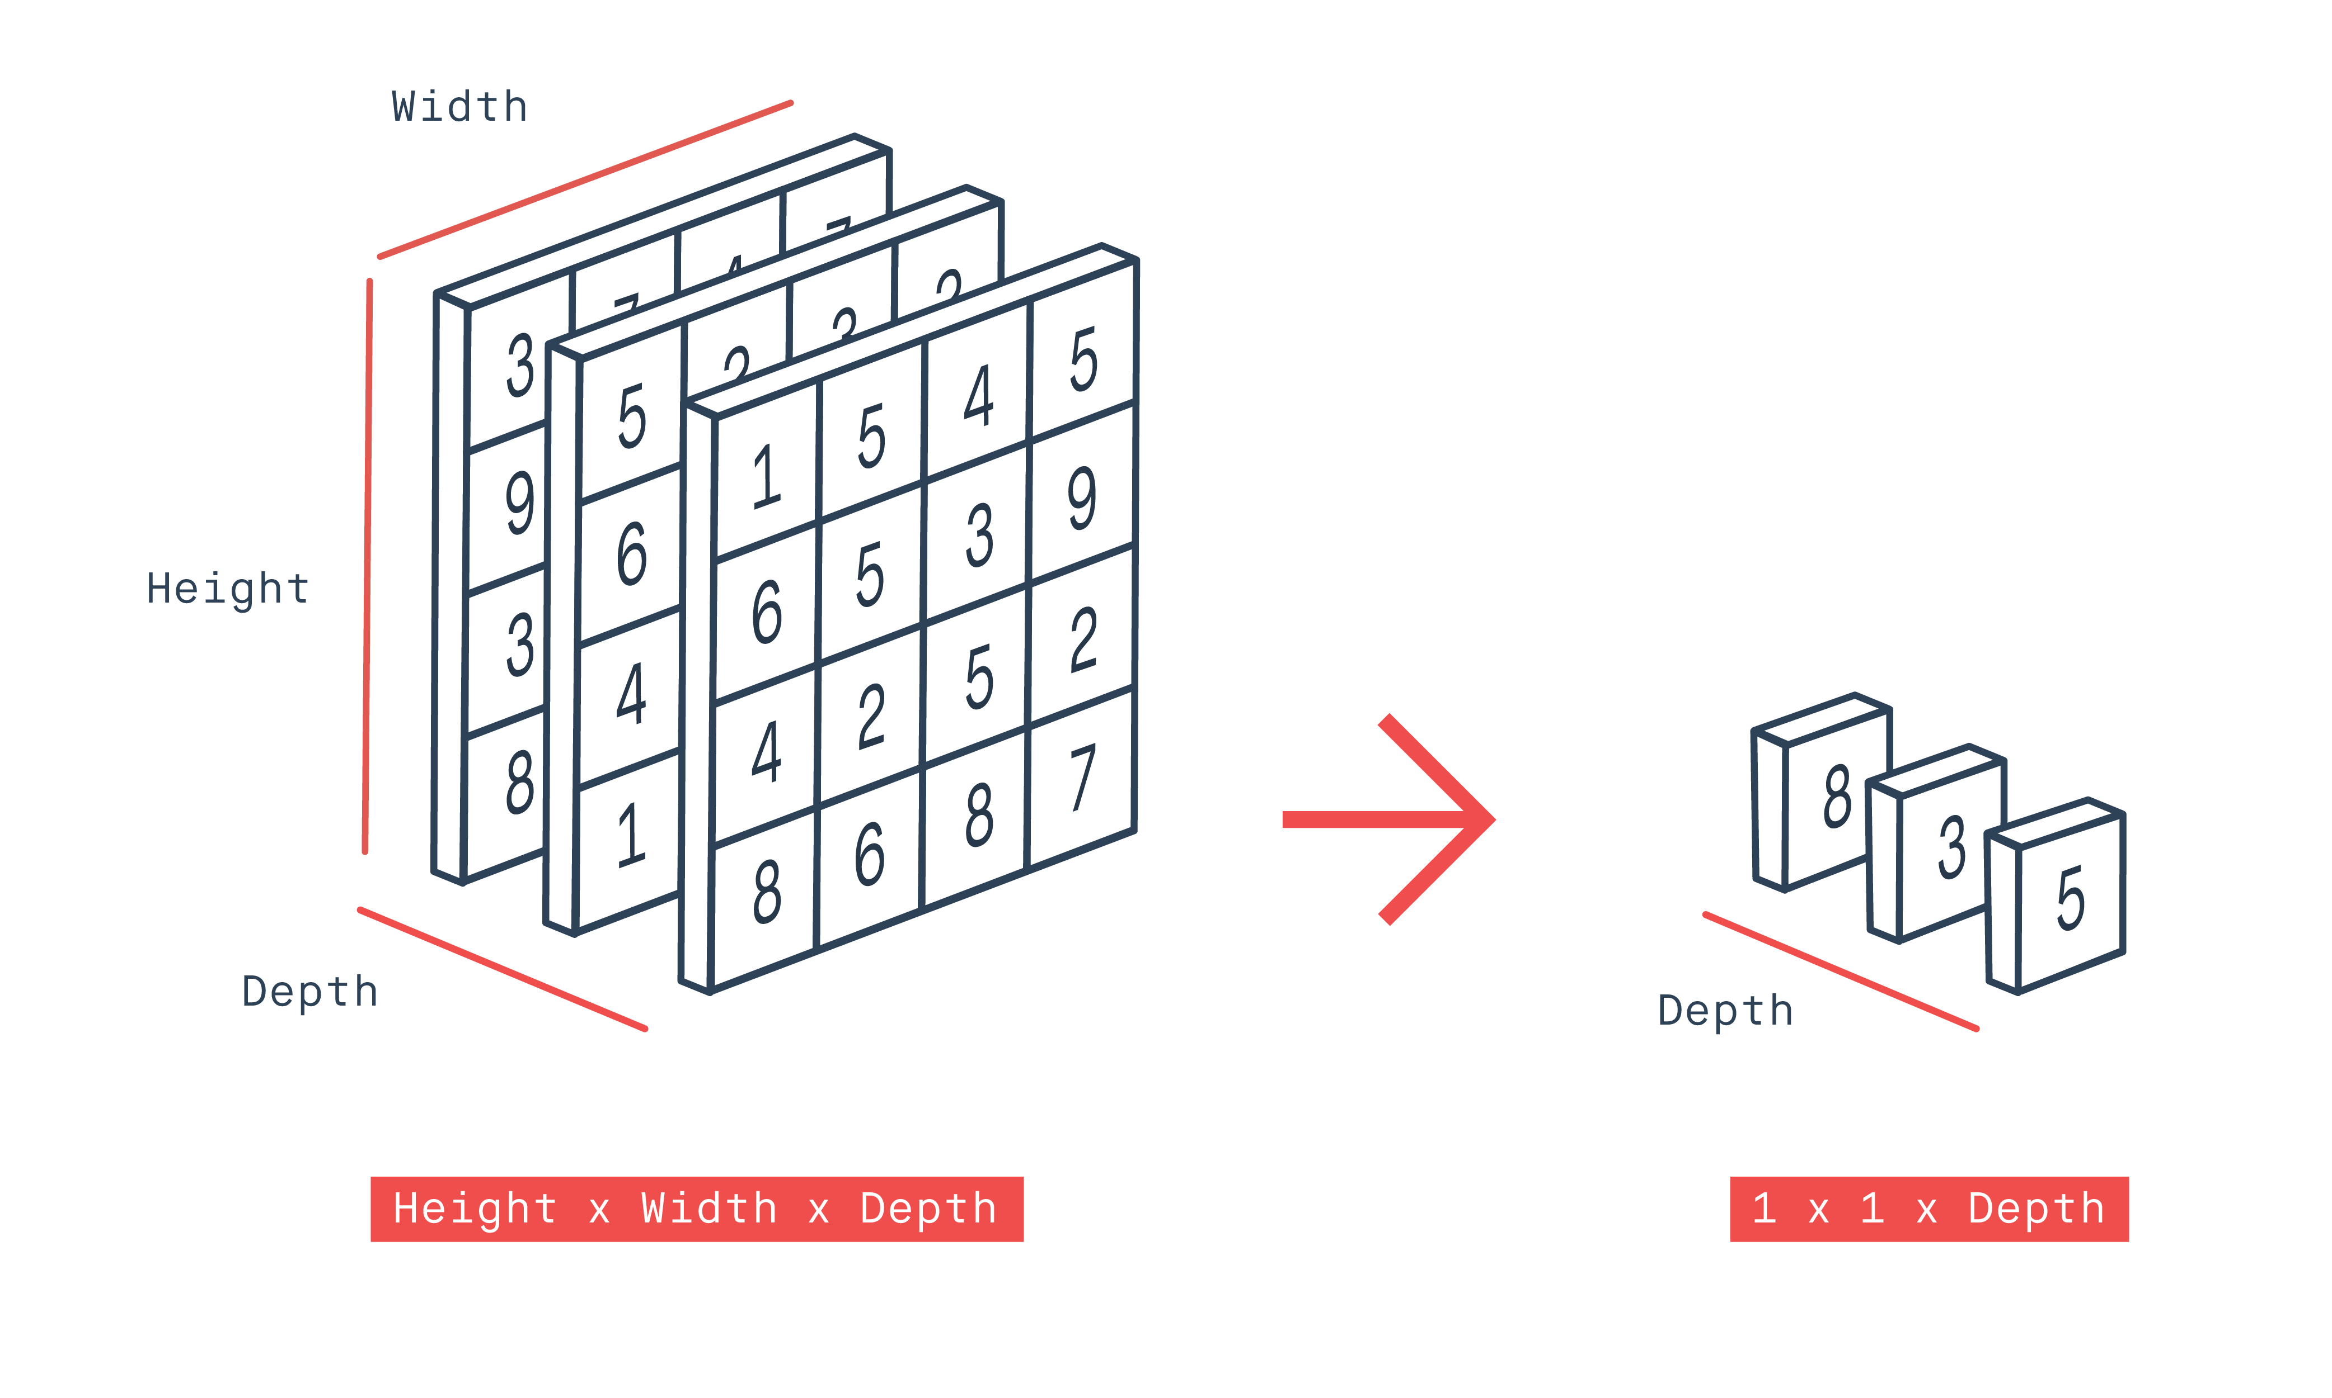
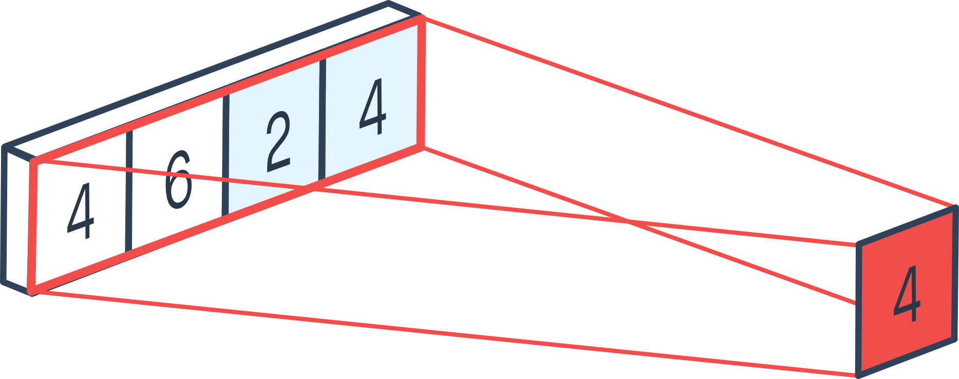
1D / 2D Global average pooling
https://peltarion.com/knowledge-center/documentation/modeling-view/build-an-ai-model/blocks/2d-global-average-pooling

Slide 9
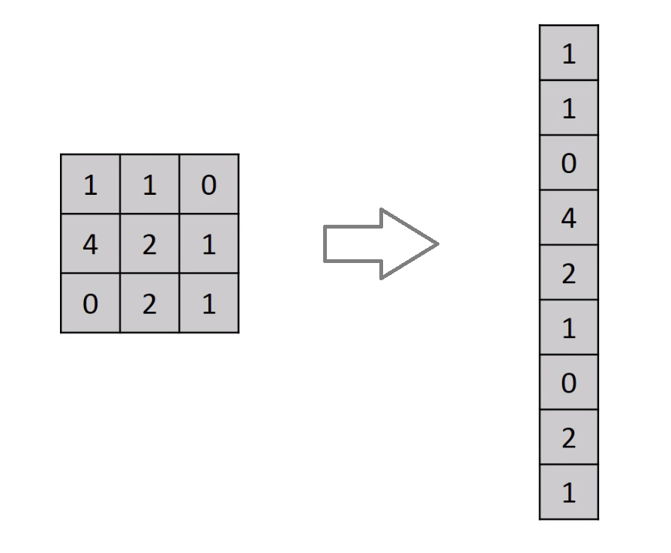
Flatten
https://medium.com/@cdabakoglu/what-is-convolutional-neural-network-cnn-with-keras-cab447ad204c

Slide 10
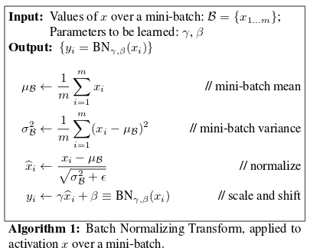
Batch normalization
(batch - mean(batch)) / (var(batch) + epsilon) * gamma + beta
epsilon is small constant
gamma is a learned scaling factor (initialized as 1)
beta is a learned offset factor (initialized as 0)
Ioffe, S., & Szegedy, C. (2015). Batch Normalization: Accelerating Deep Network Training by Reducing Internal Covariate Shift. PMLR. http://proceedings.mlr.press/v37/ioffe15.html

Slide 11
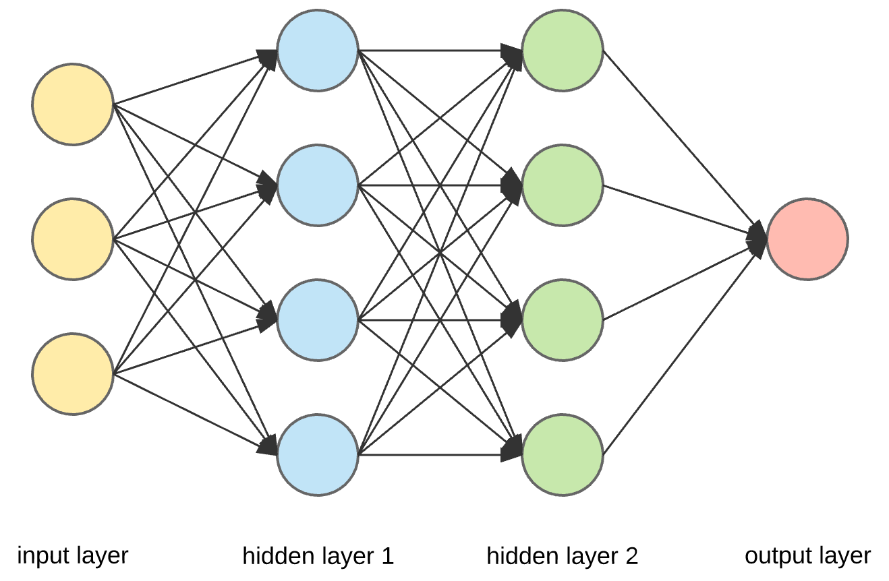
Dense (fully connected)
https://medium.com/@cdabakoglu/what-is-convolutional-neural-network-cnn-with-keras-cab447ad204c

Slide 12
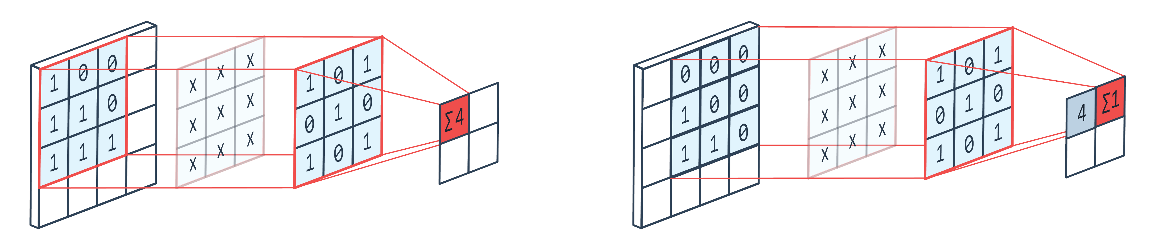
2D Convolution block
kernel (macierz wag)
5×5=25 cech wejściowych i 3×3=9 cech wyjściowych Gdyby to była warstwa w pełni połączona macierz wag miałaby: 25×9 = 225 parametrów
https://peltarion.com/knowledge-center/documentation/modeling-view/build-an-ai-model/blocks/2d-convolution-block

Slide 13
Deconvolution (transposed Convolution)
https://towardsdatascience.com/types-of-convolution-kernels-simplified-f040cb307c37

Slide 14
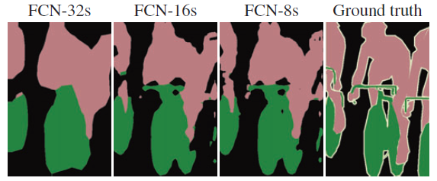
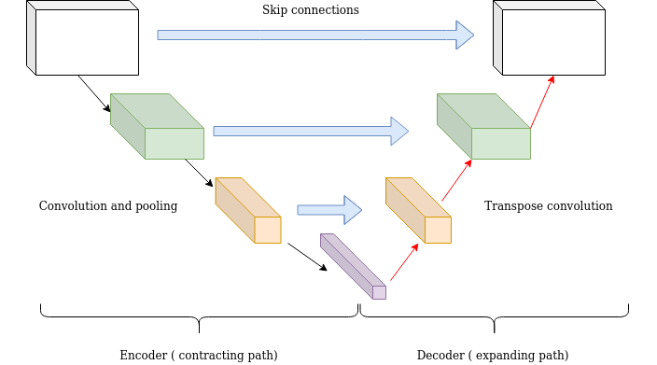
Skip connections
https://theaisummer.com/skip-connections/

Slide 15
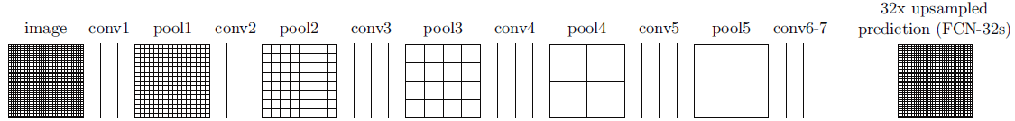
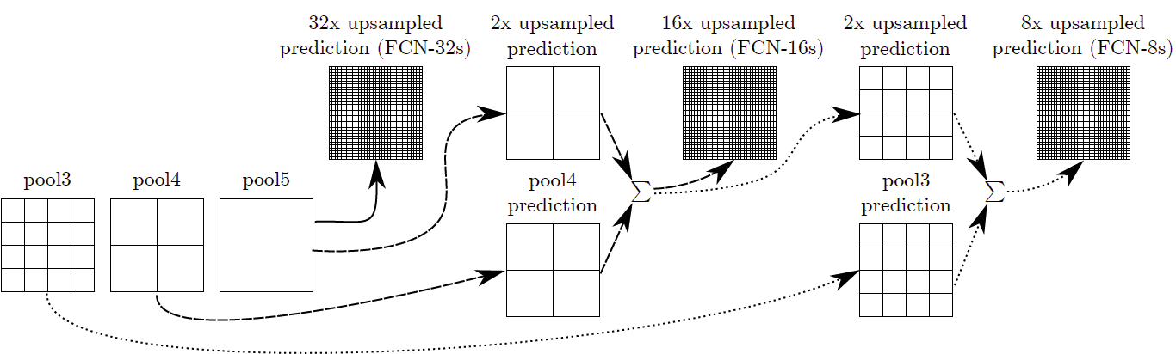
Skip connections
https://towardsdatascience.com/review-fcn-semantic-segmentation-eb8c9b50d2d1

Slide 16
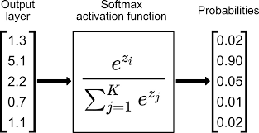
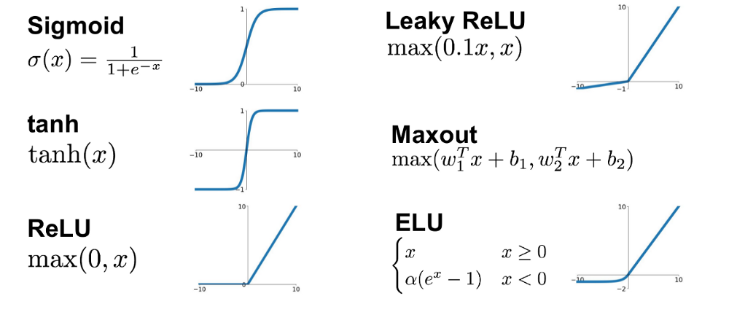
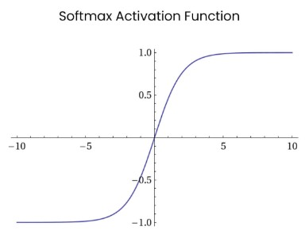
Funkcje aktywacji
∑1.00
https://towardsdatascience.com/softmax-activation-function-explained-a7e1bc3ad60 https://krisbolton.com/a-quick-introduction-to-artificial-neural-networks-part-2 https://laptrinhx.com/complete-guide-of-activation-functions-574622854

Slide 17
input_shape = (28, 28, 1) NUM_CLASSES = 10 model = keras.Sequential( [ keras.Input(shape=input_shape), layers.Conv2D(64, kernel_size=(3, 3), activation="relu"), layers.MaxPooling2D(pool_size=(2, 2)), layers.BatchNormalization(), layers.Conv2D(128, kernel_size=(3, 3), activation="relu"), layers.GlobalAveragePooling(), layers.BatchNormalization(), layers.Dense(512, activation="relu"), layers.Dense(NUM_CLASSES, activation="softmax"), ] )
https://peltarion.com/knowledge-center/documentation/modeling-view/build-an-ai-model/blocks/

Slide 18
Przykłady architektur sieci neuronowych

Slide 19
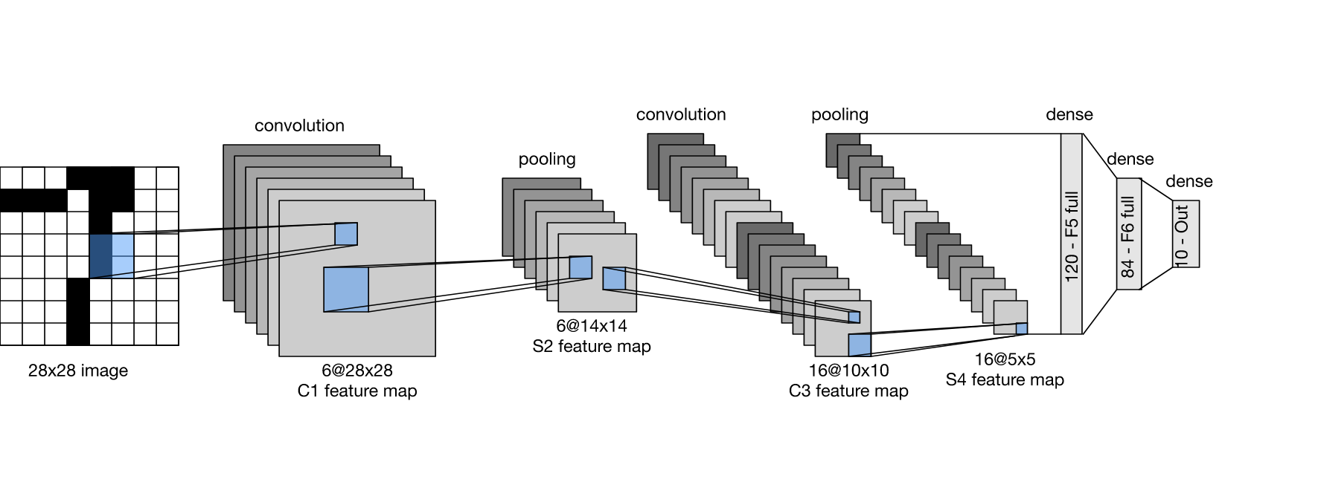
LeNet
https://colab.research.google.com/github/d2l-ai/d2l-tensorflow-colab/blob/master/chapter_convolutional-neural-networks/lenet.ipynb

Slide 20
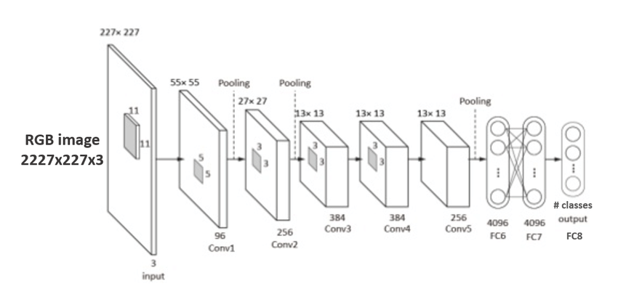
AlexNet
https://www.researchgate.net/figure/AlexNet-architecture-Includes-5-convolutional-layers-and-3-fullyconnected-layers_fig3_322592079

Slide 21
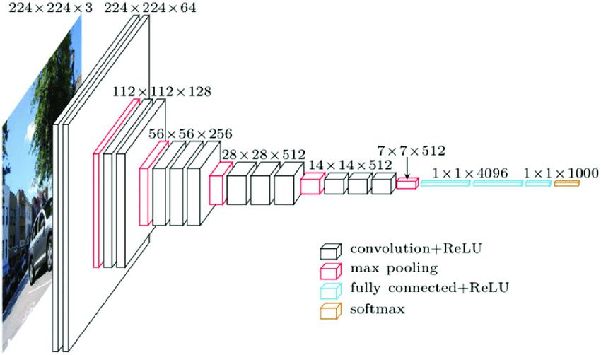
VGG
https://www.researchgate.net/figure/An-overview-of-the-VGG-16-model-architecture-this-model-uses-simple-convolutional-blocks_fig2_328966158

Slide 22
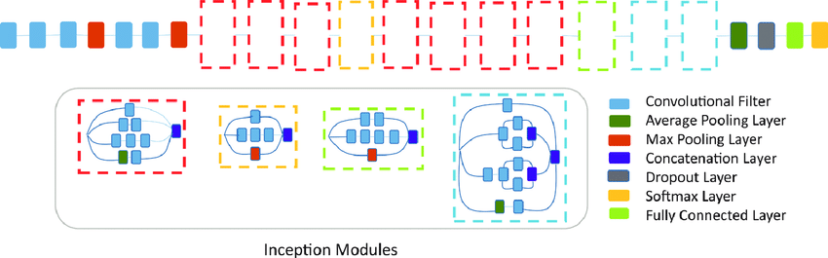
InceptionNet/GoogLeNet (inception modules)
https://www.researchgate.net/figure/Convolutional-neural-network-architecture-Inception-v3-used-in-this-study-Inception-v3_fig3_328775405

Slide 23
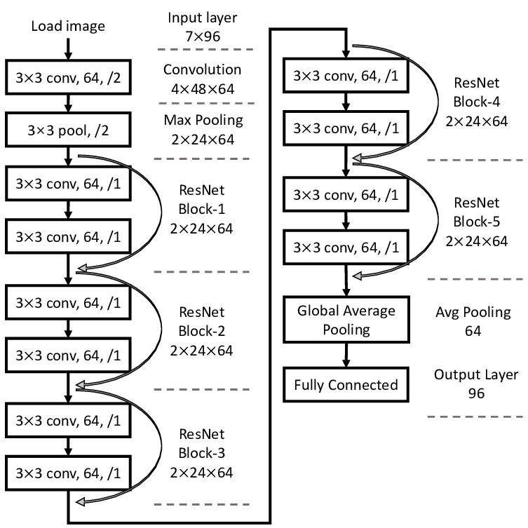
ResNet
https://www.researchgate.net/figure/The-structure-of-ResNet-12_fig1_329954455

Slide 24
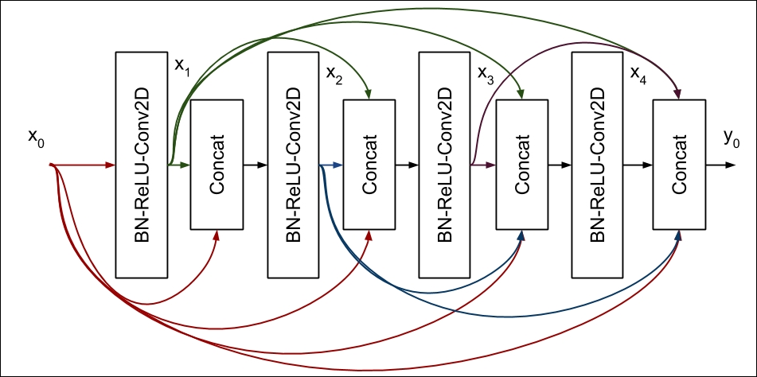
DenseNet
https://subscription.packtpub.com/book/big_data_and_business_intelligence/9781788629416/2/ch02lvl1sec14/densely-connected-convolutional-networks-densenet

Slide 25
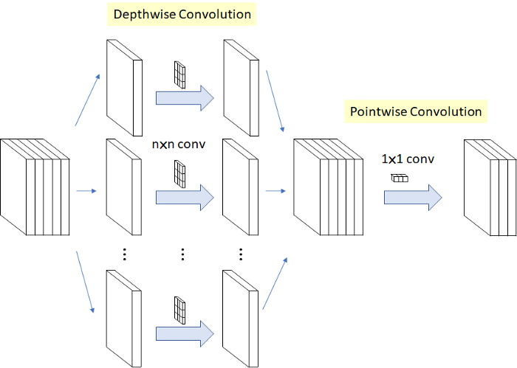
Xception
https://towardsdatascience.com/review-xception-with-depthwise-separable-convolution-better-than-inception-v3-image-dc967dd42568

Slide 26
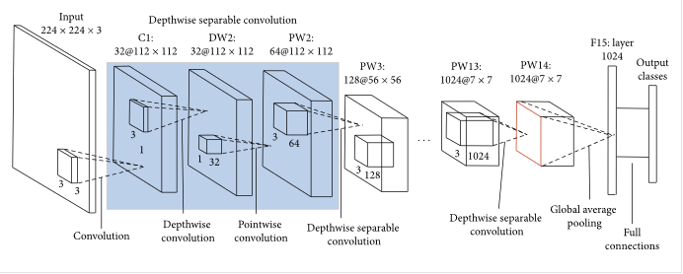
MobileNet
https://towardsdatascience.com/review-xception-with-depthwise-separable-convolution-better-than-inception-v3-image-dc967dd42568

Slide 27
**Konwolucyjne sieci neuronowe**
LeNet, AlexNet, VGG
ResNet, DenseNet
Inception
Xception, MobileNet
Fully Convolutional Network, DeconvNet (segmentacja)
**Rekurencyjne sieci neuronowe**
komórka LSTM
komórka GRU
bidirectional RNN
**Uczenie nienadzorowane**
self organizing maps, można na przykładzie sieci Kohonena
Restricted Boltzmann machine
autoenkoder wariacyjny VAE
**Różności**
Siamese Network
R-CNN
Mask R-CNN
Attention Module

